Slide 1

Physical Evidence

Slide 2
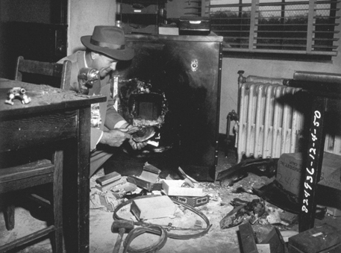
Physical Evidence is all objects that can establish…
1) that a crime has been committed
or
2) a link between a crime and its victim
or
3) a link between a crime and its perpetrator

Slide 3
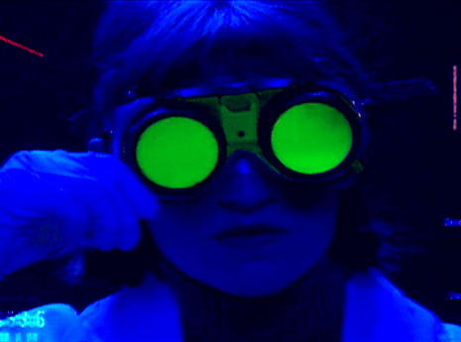
The forensic scientist’s role is…
(A) Identification
What is the physical object?
(B) Comparison
Can it be linked to a specific individual?
Determine the probability that the suspect was involved with the crime
(C) Expert testimony

Slide 4
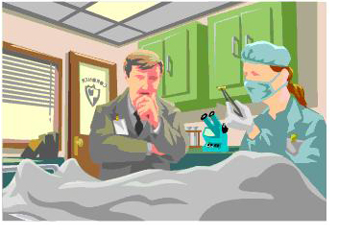

Physical evidence involves individual characteristics and class characteristics
What does this mean?

Slide 5

What is individual characteristic evidence?
Evidence that associates a specific individual with a crime
Examples:
Fingerprints
DNA
Lip-prints
Bullet markings

Slide 6
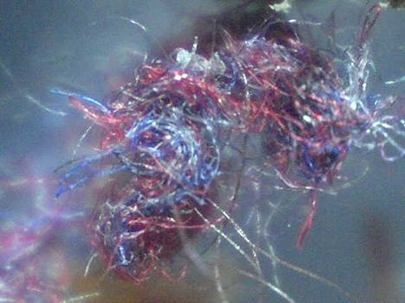
What is class characteristic evidence?
Evidence by itself that does not associate an individual with a crime (group evidence)
Examples:
Fibers
Blood type
Shoeprints
Tire tracks

Slide 7
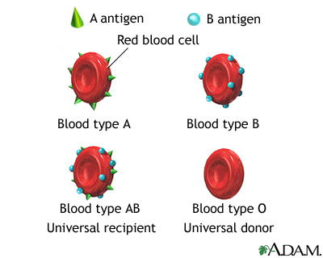
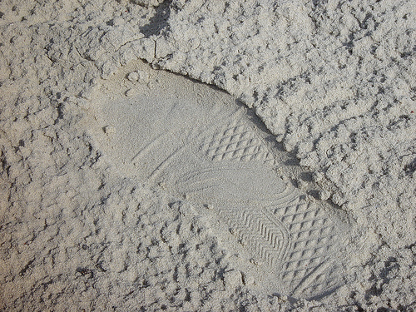
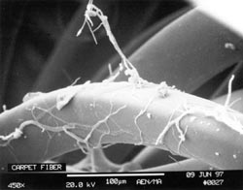
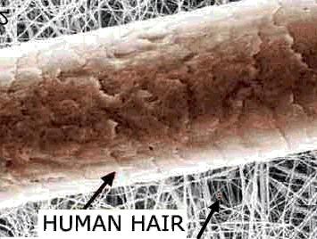
Product rule in relation to class characteristic evidence
Multiply the probability of each class characteristic

Slide 8
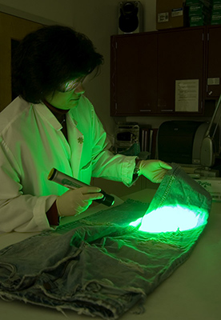
Trace Evidence
Evidence that is small in amount or small in size

Slide 9
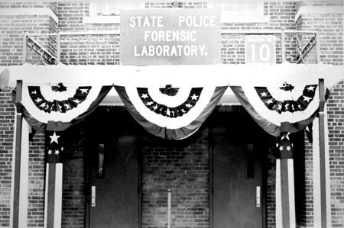
Crime
Lab
Physical science unit
Biology unit
Firearms unit
Document examination unit
Photography unit
Toxicology unit
Latent fingerprint unit
Voiceprint analysis unit
Overview of services; crime labs may vary

Slide 10
